Slide 1

Steam Game Data (May 2024)
CWU - CS 456
December 2025
Presented by
Ian Seymour
Adrian Rivera
Guillermo Leon
Group 5

Slide 2

Introduction
Project Goals:
Using the Steam Game dataset, determine what factors influence a game’s reception from players and critics.
The Steam Game dataset:
Collected by web scraping,
Contains 46 columns,
Game data collected for all games on Steam,
Extensive but sparse data,
High dimensionality
Group 5

Slide 3
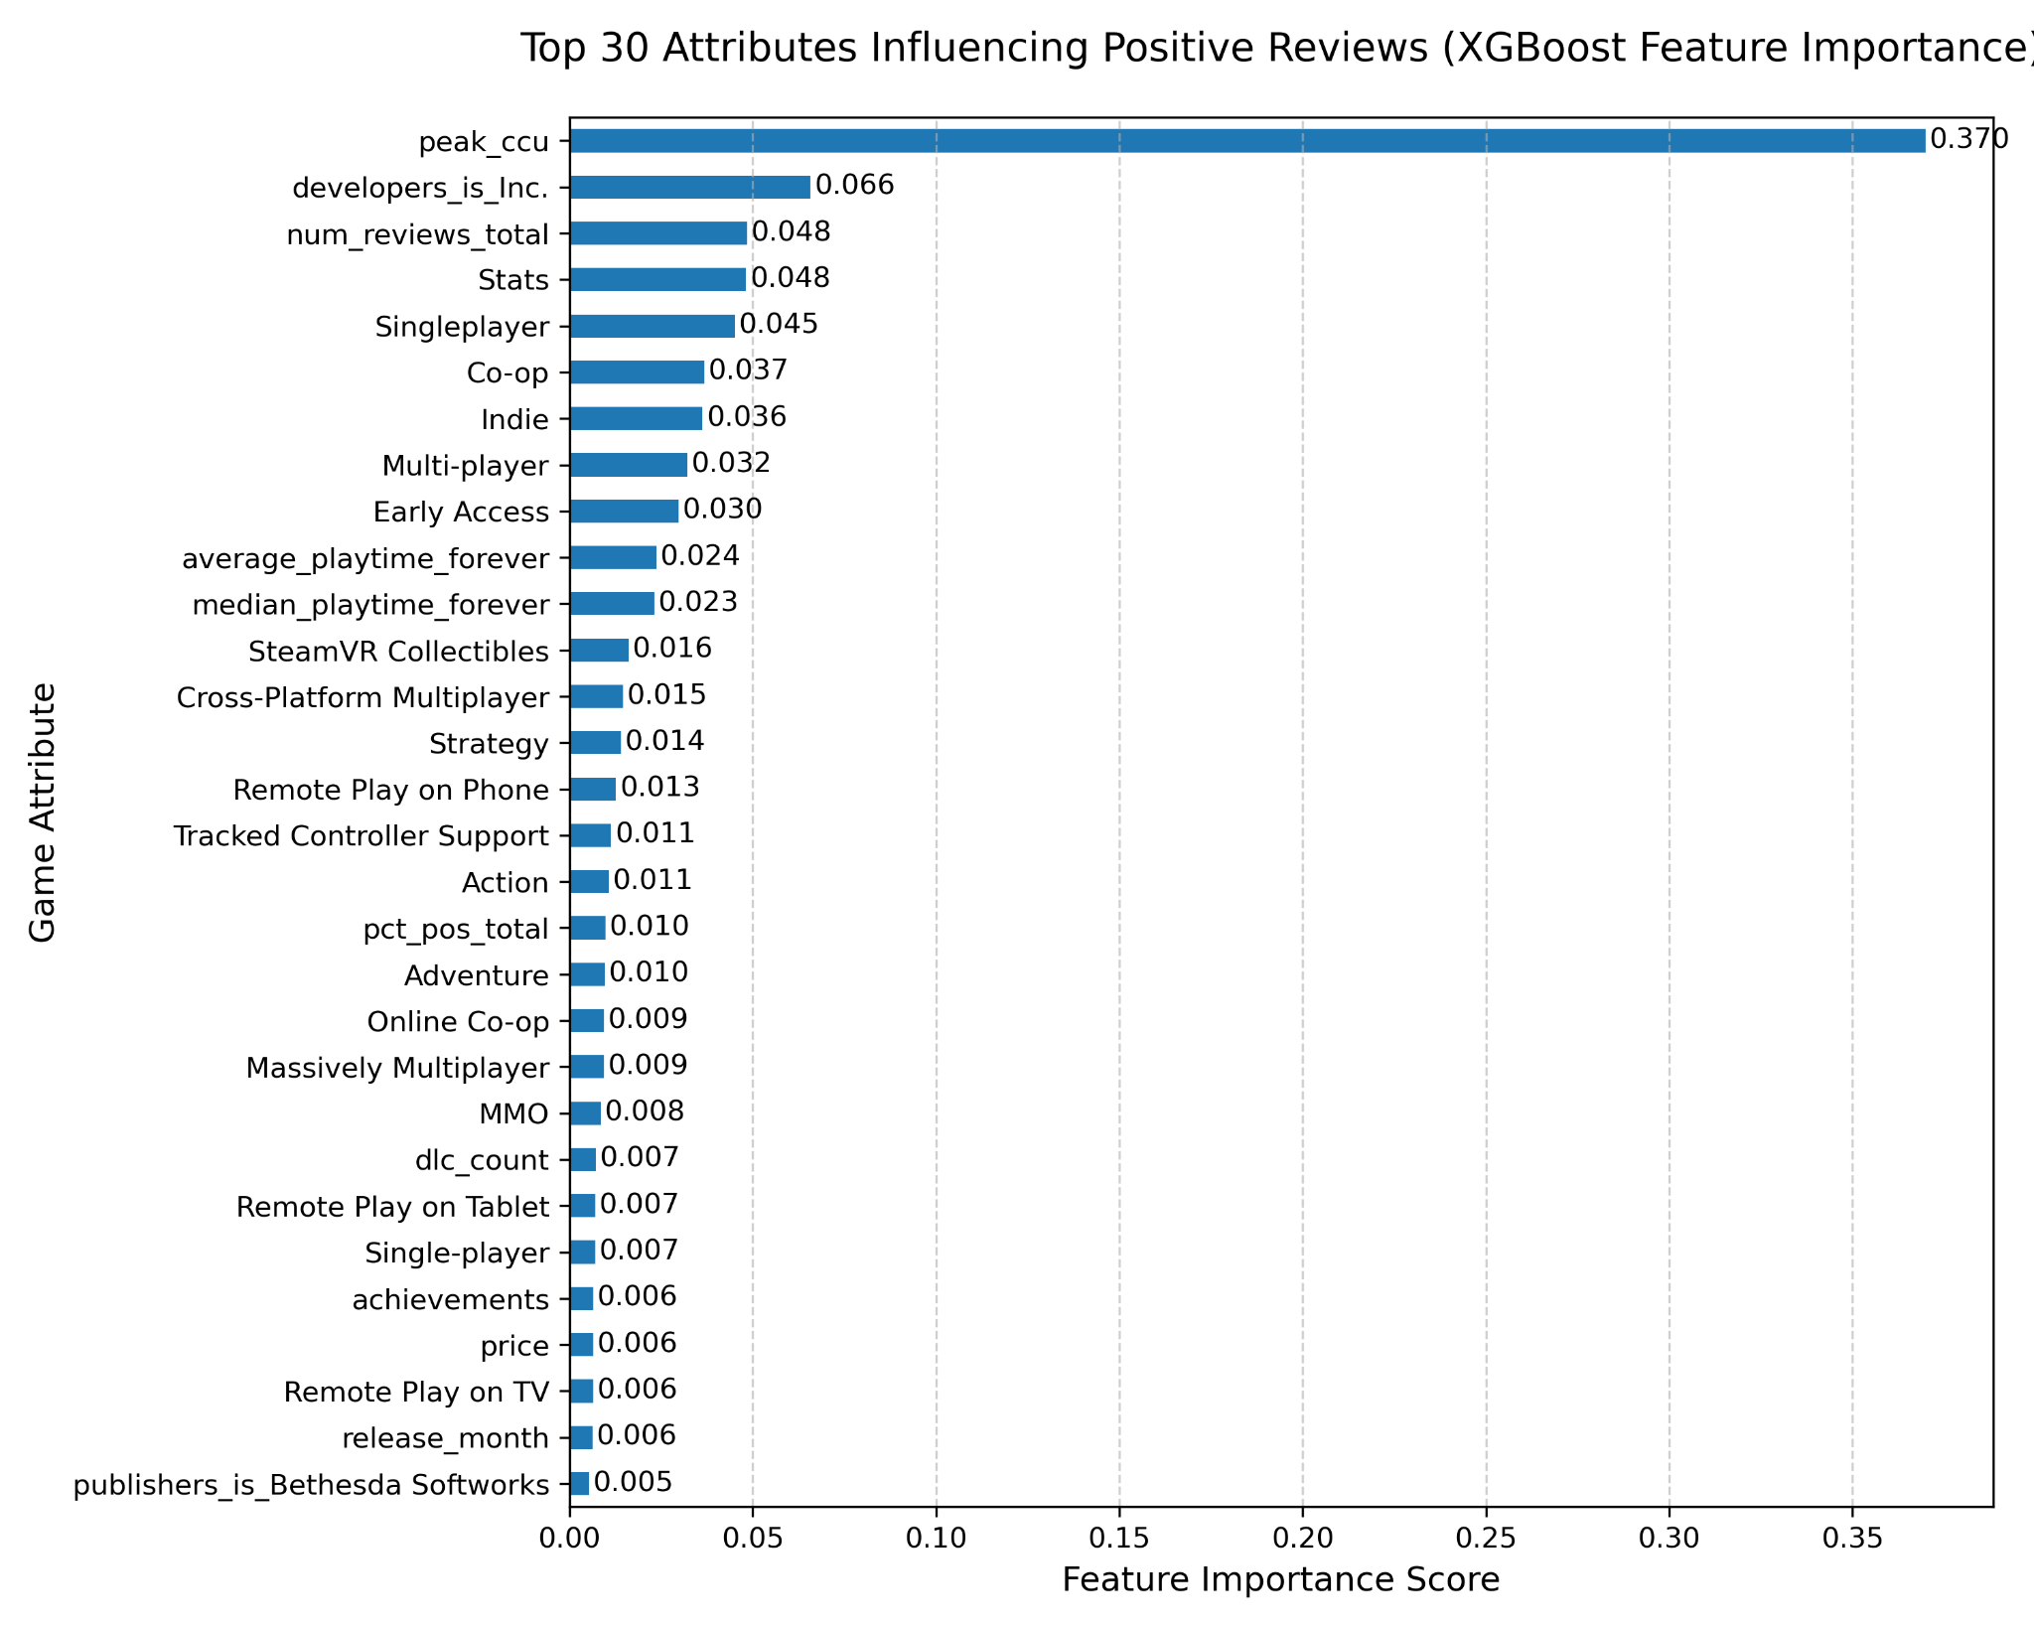
What game attributes are most important to positive reviews?
Question 1:
WIth an XGP Regression, the top 30 most important characteristics for positive reviews can be found.
Group 5

Slide 4
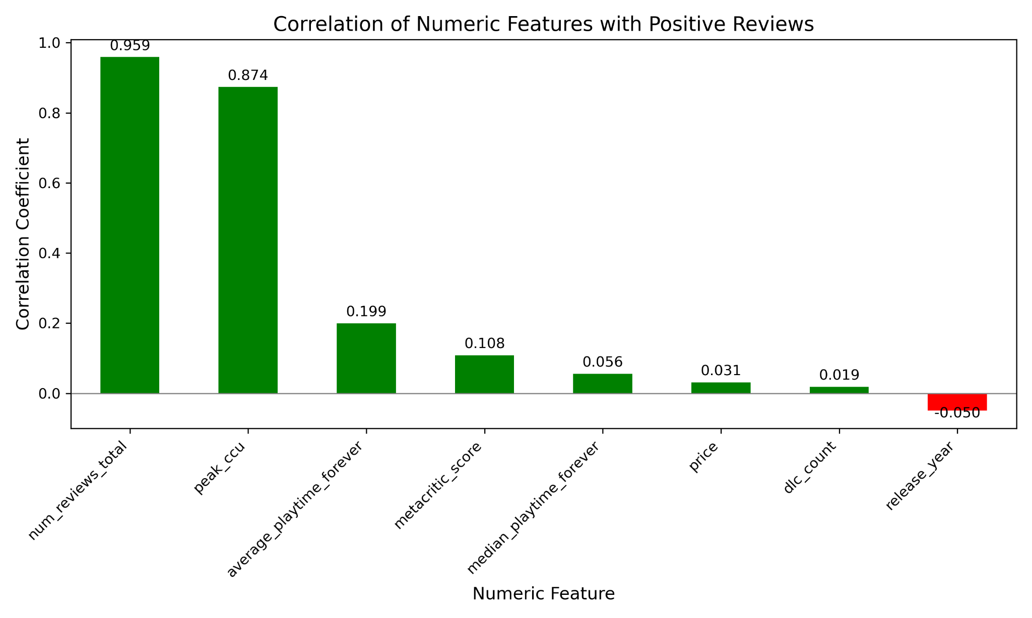
What game attributes are most important to positive reviews?
Question 1:
Calculating the positive and negative correlations for numerical categories yields these traits.
Group 5

Slide 5
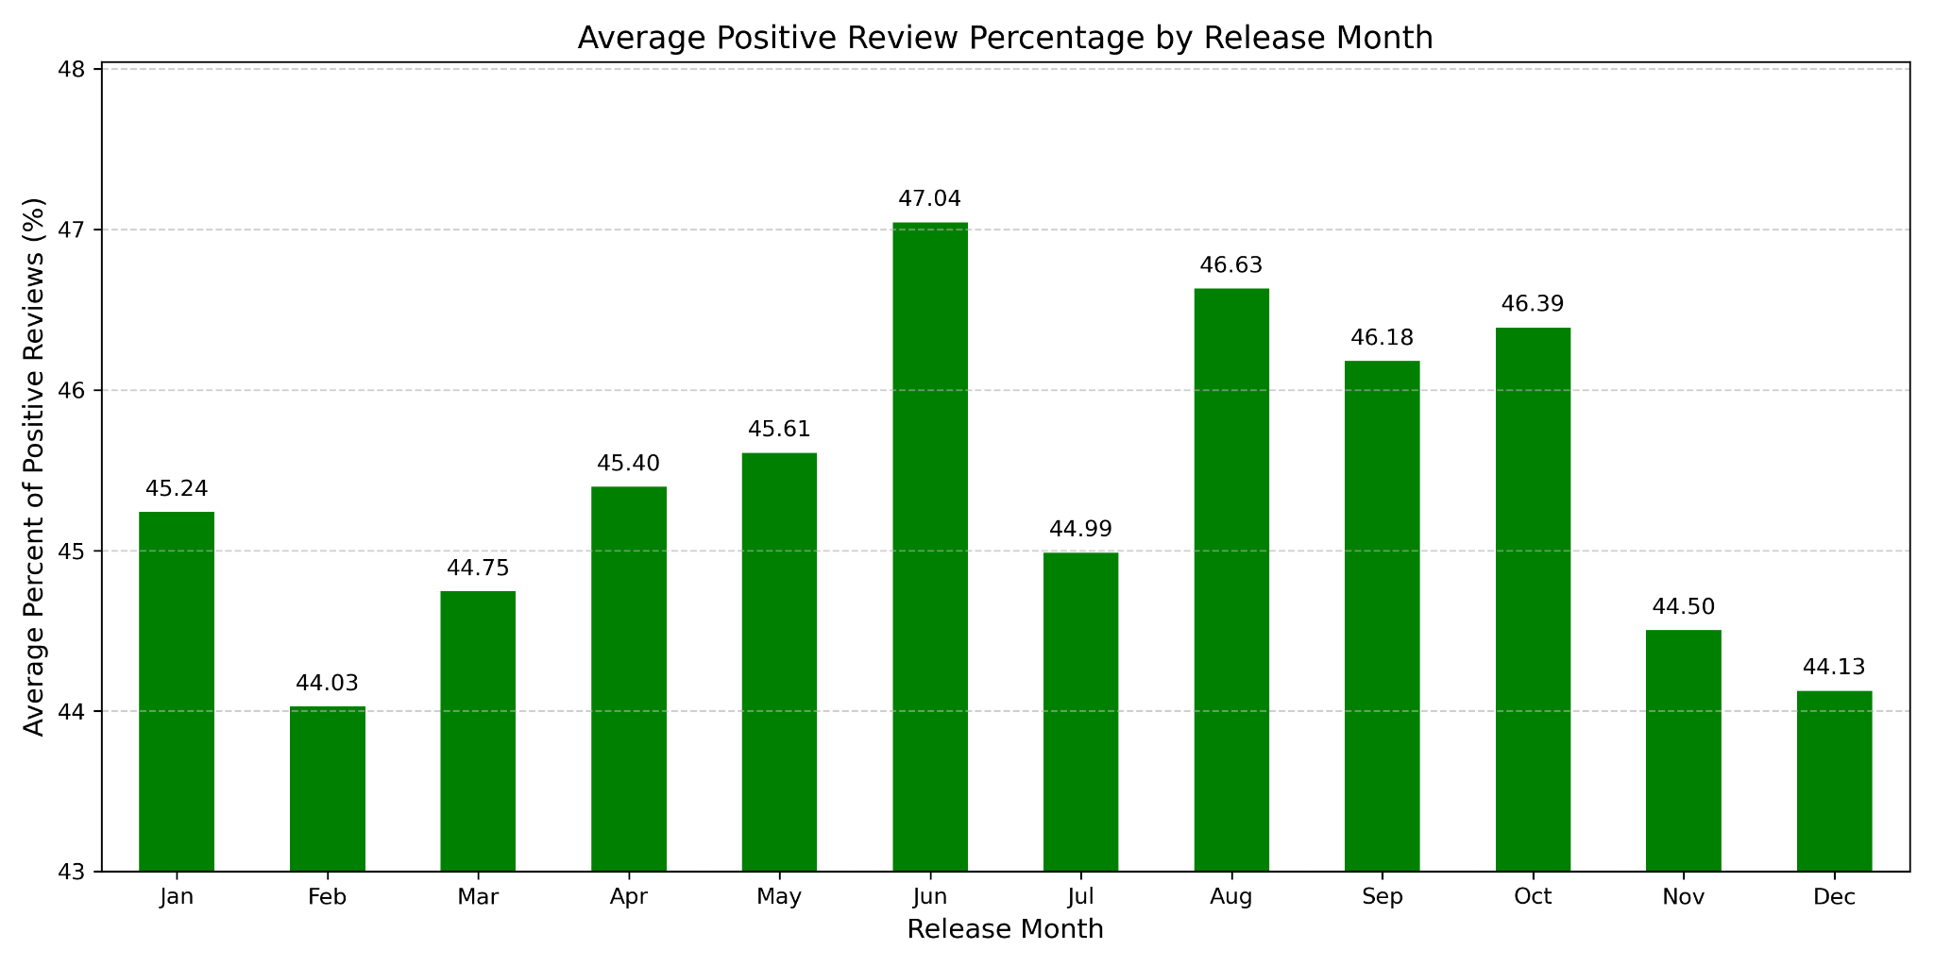
What impact does release date have on percent of positive reviews?
Question 2:
Ignoring the specific day, to answer this question it is better to focus on release year and release month as separate attributes.
Release month had a minor impact on average positive review percentage.
Group 5

Slide 6
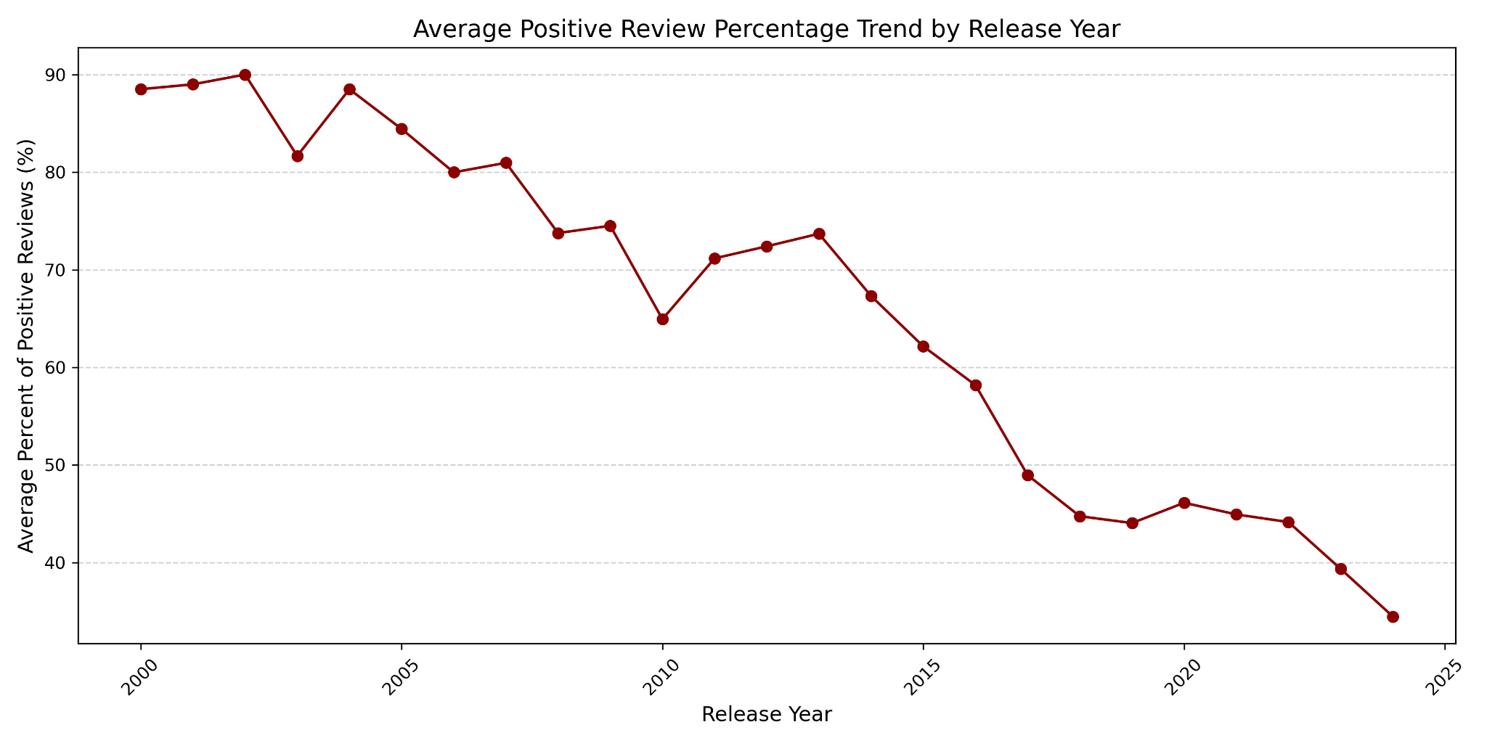
What impact does release date have on percent of positive reviews?
Question 2:
For release year, an interesting trend is revealed: overall player satisfaction (average percentage of positive reviews) has consistently declined every year.
Group 5

Slide 7
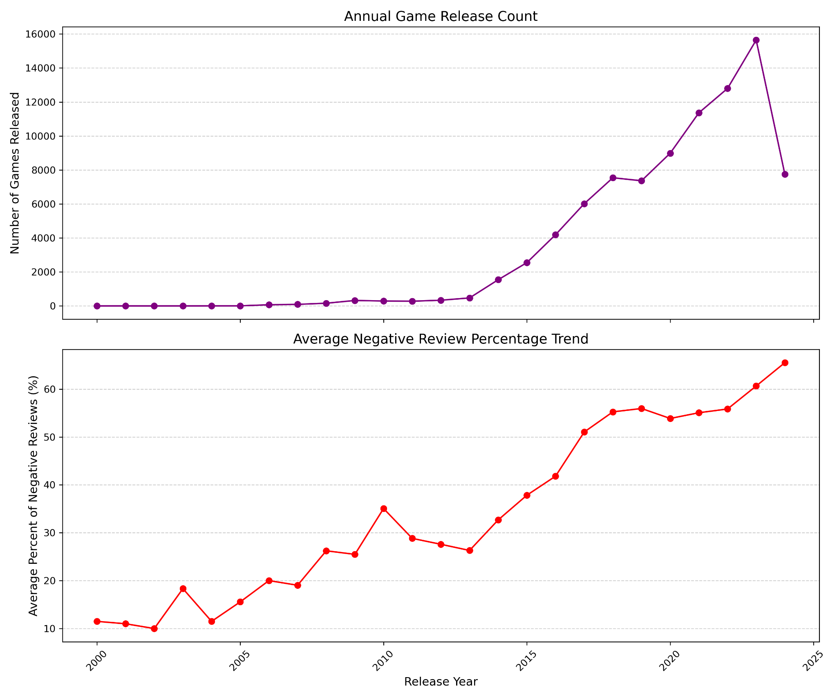
Question 2:
Group 5

Slide 8
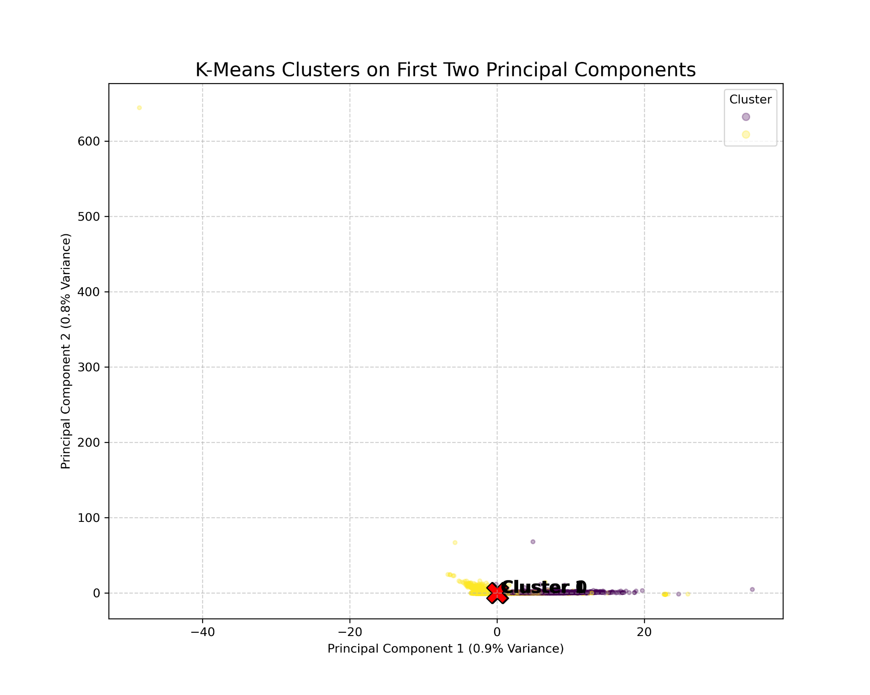
What clusters can be made from the many game attributes?
Question 3:
K-Means reveals that the optimal k is 2, which results in a somewhat messy group of clusters.
These clusters only account for a small percentage of variance, but the model is 91% accurate according to K-Nearest Neighbors.
Group 5

Slide 9
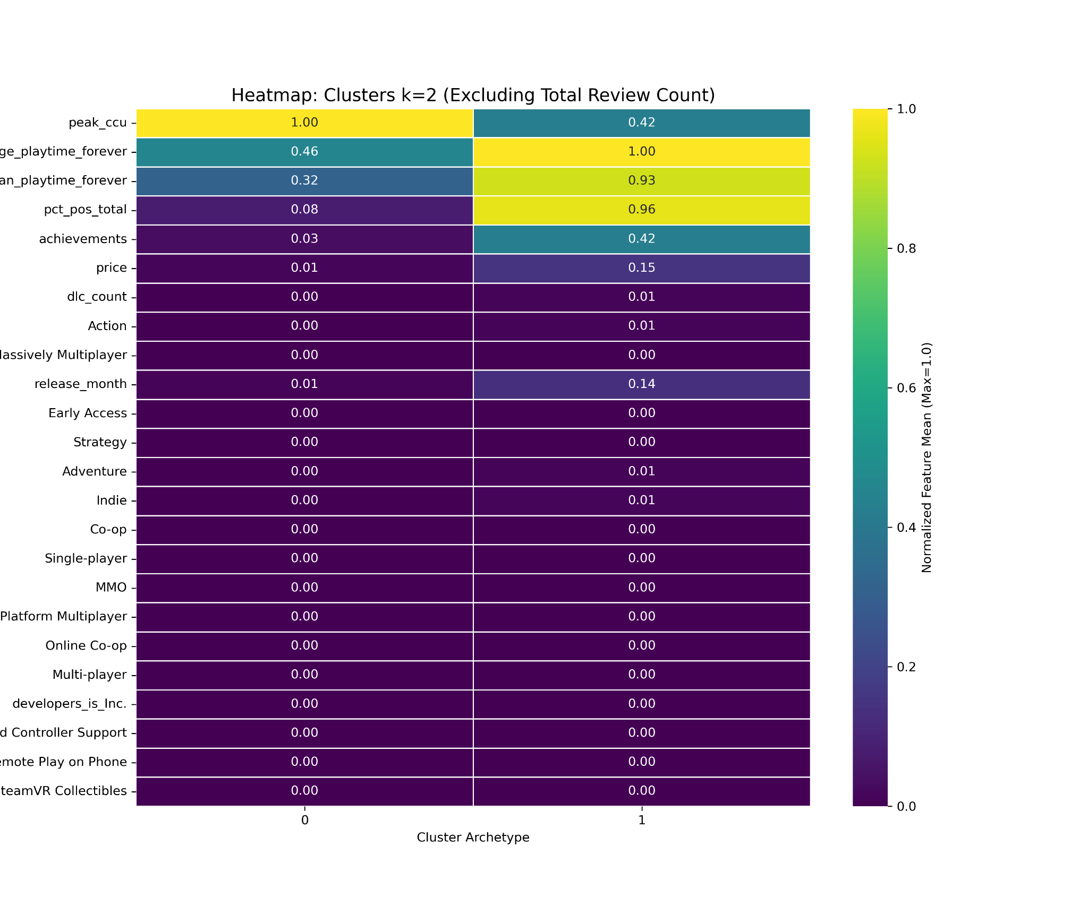
What clusters can be made from the many game attributes?
Question 3:
There are two distinct clusters:
Cluster 0:
Blockbuster games with high initial peak concurrent users.
Cluster 1:
Games that satisfy players long term but might not be immediate hits.
Group 5

Slide 10
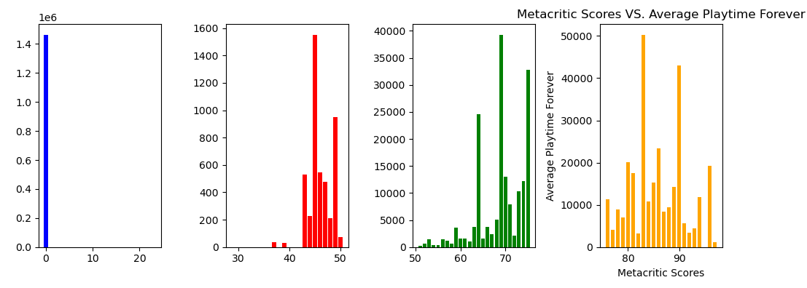
Does metacritic scores affect the average playtime forever?
Question 4:
Yes and no:
  Yes, the higher the score the more time overall is spent playing games over their lifetime.
  No, while games with lower scores still do not compare in overall time, they still have plenty of time spent in game.
Group 5

Slide 11
Does metacritic scores affect the average playtime forever?
Question 4:
Over abundance of ‘0’ score value:
  Lead to data for the score to be uninterpretable.
Group 5

Slide 12
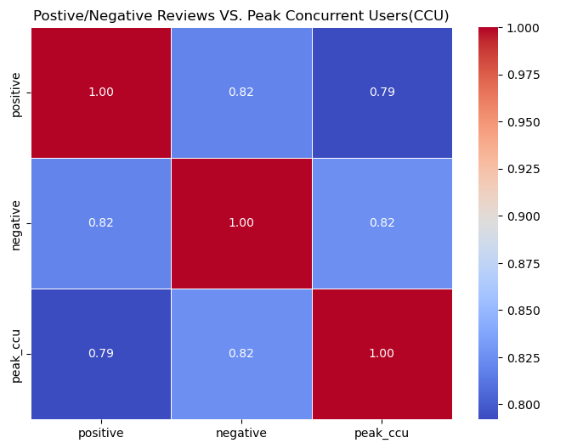
Do positive/negative reviews affect peak concurrent users (CCU)?
Question 5:
Negative reviews had a higher correlation with peak CCU, though marginal.
Positive reviews had a lower correlation with peak CCU.
Group 5

Slide 13
Do positive/negative reviews affect peak concurrent users (CCU)?
Question 5:
Possible explanation:
  Game is negatively reviewed overall but people still try it.
  Reviews are mixed yet still overall negative.
  Review Bombing.
Group 5

Slide 14
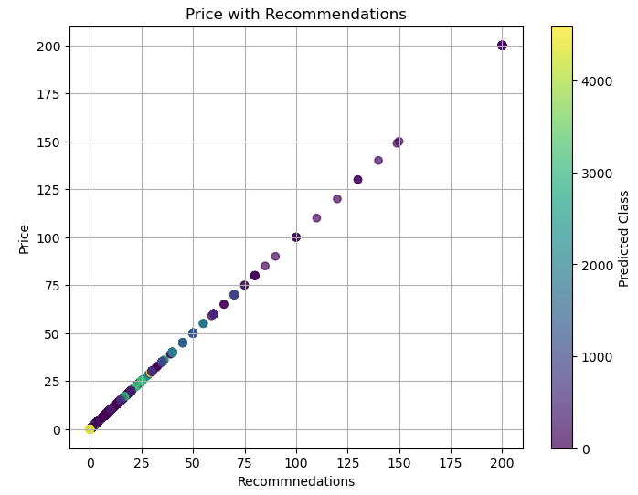
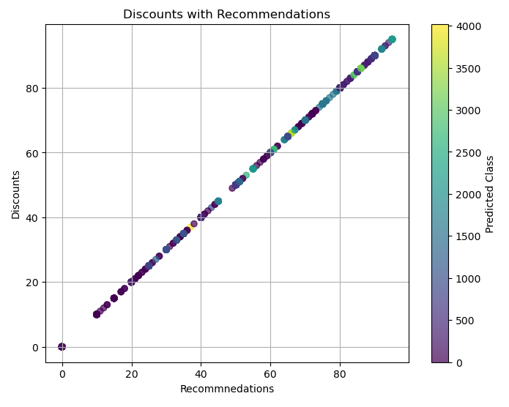
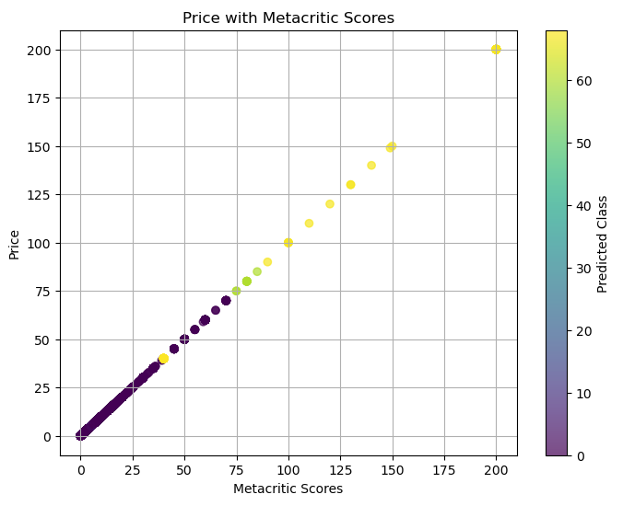
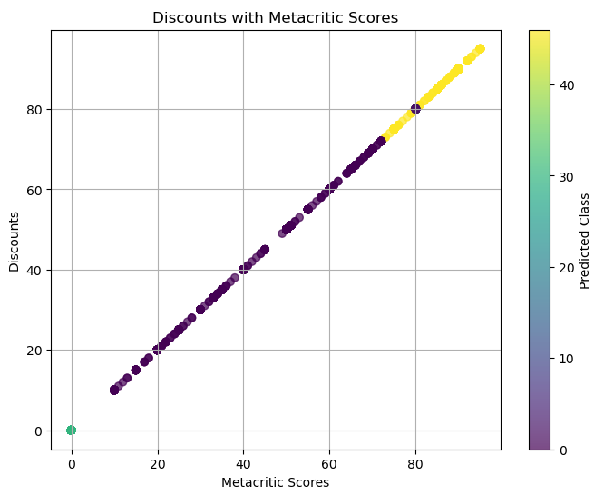
Is price or discounts affected by the amount of recommendations given or metacritic scores?
Question 6:
Price:
  Recommendations:
    Was not predicted to be a determining factor for price.
  Metacritic Score:
    The higher the score the higher chance of price to be higher.
  Outlier:
    Metacritic scores above 100.
Group 5

Slide 15
Is price or discounts affected by the amount of recommendations given or metacritic scores?
Question 6:
Discounts:
  Recommendations:
    Was not predicted to be a determining factor for discounts.
  Metacritic Score:
    Higher scores predicted to have a higher likelihood of being discounted .
Group 5

Slide 16
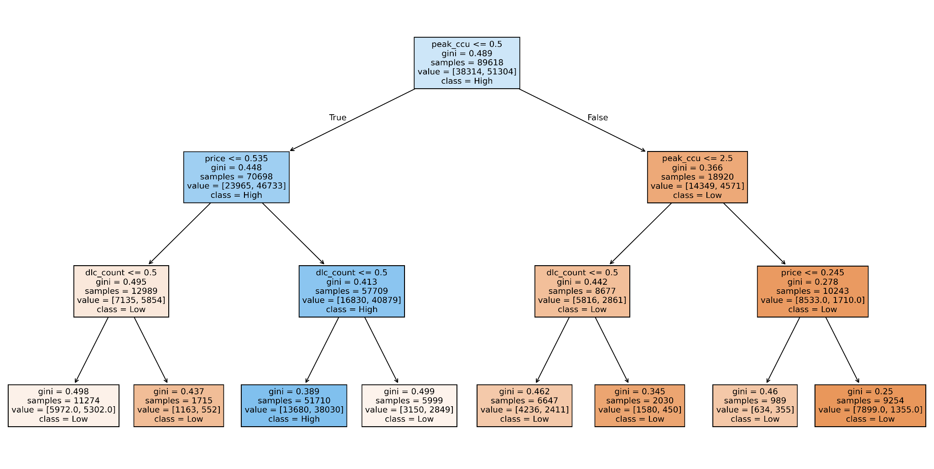
Which game characteristics predict High/Low review scores?
Question 7:
Model: Decision Tree Classifier (max depth = 3)
Key predictors: playtime, peak CCU, price, and DLC count.
Biggest takeaway: Games with more DLC’s and high player engagement (CCU) tended to receive higher review scores, while lower-priced games leaned toward lower scores.
Group 5

Slide 17
Which game characteristics predict High/Low review scores?
Question 7:
What the Tree Reveals
Review outcomes are influenced mostly by engagement and content depth, not necessarily by simple attributes like genre or platform.
The tree suggest that players rate games more positively when the game is actively played and continuously updated with DLC.
Price has influence, but only after DLC and CCU are considered.
Group 5

Slide 18
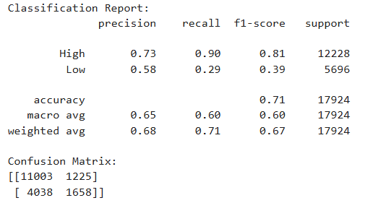
Based on the price of a game, is it likely to have mostly positive/Negative reviews?
Question 8:
Model: Gaussian Naive Bayes
Target: review_category (HIgh vs Low)
Feature: Price
Train/Test Split: 80/20
Key Points: price was chosen because it was relatively evenly distributed compared to other numeric features.
Model struggled with imbalance classes
Group 5

Slide 19
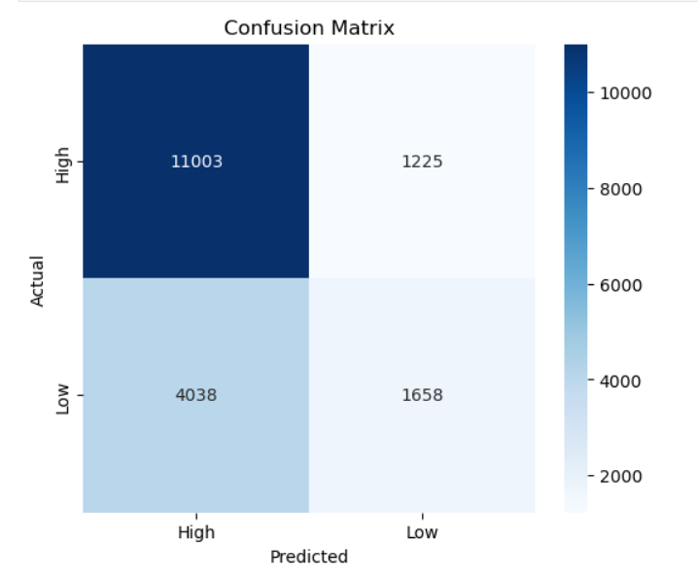
Based on the price of a game, is it likely to have mostly positive/Negative reviews?
Question 8:
Observations:
Model predicts High-review games well (recall 90%)
Struggles with Low-review games (recall 29%)
Misclassification is mostly Low to High, which indicates a bias toward the majority class.

Slide 20
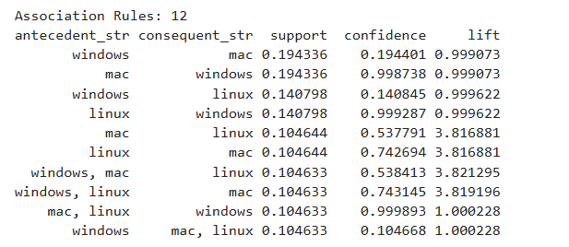
Which platforms tend to appear together for the same games?
Question 9:
Model: Apriori + Association Rules
Features: platforms (Windows, Mac, Linux)
Observations:
Linux and Mac have the strongest co-occurrence
Windows and Mac often appear together, but less unexpectedly than Linux and Mac
This Helps us predict platform availability if one platform is already known.
Group 5

Slide 21
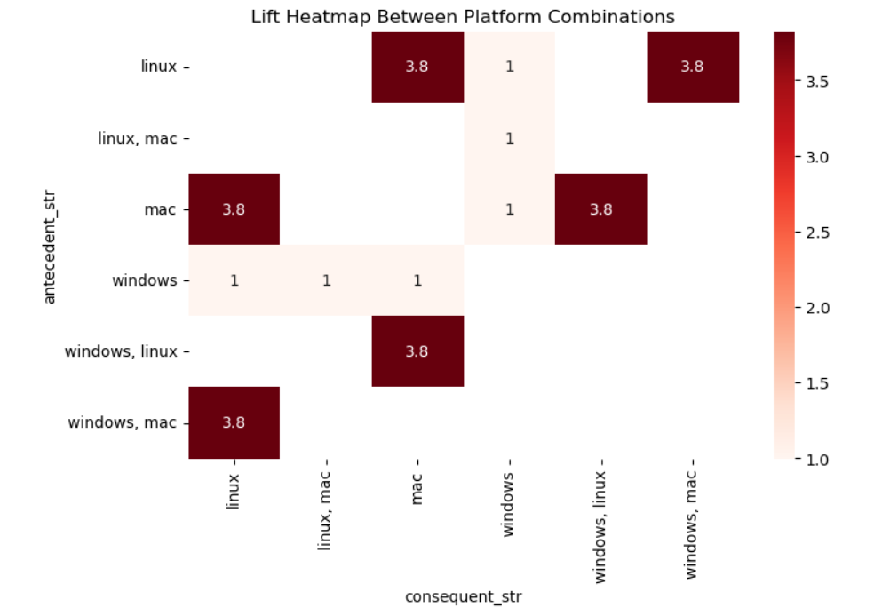
Which platforms tend to appear together for the same games?
Guillermo Leon
Question 9:
Windows and Mac often appear together, but LInux and Mac has a higher lift of 3.8, meaning its more frequent than random chance.
Rules with lift > 1 indicate a strong positive correlation between platforms.
Supports identifying cross-platform trends in games.
Group 5

Slide 22
Q & A
Group 5

